Slide 1
IP Subnetting – Zero to Hero Variable-Length Subnet Mask (VLSM)
CyberQuince

Slide 2
Variable-Length Subnet Mask (VLSM)
Unlike Fixed-Length subnetting, Variable-Length subnetting creates a hierarchical IP address space

Slide 3
Variable-Length Subnet Mask (VLSM)
Unlike Fixed-Length subnetting, Variable-Length subnetting creates a hierarchical IP address space, making it possible to create subnets without wasting large number of addresses.

Slide 4
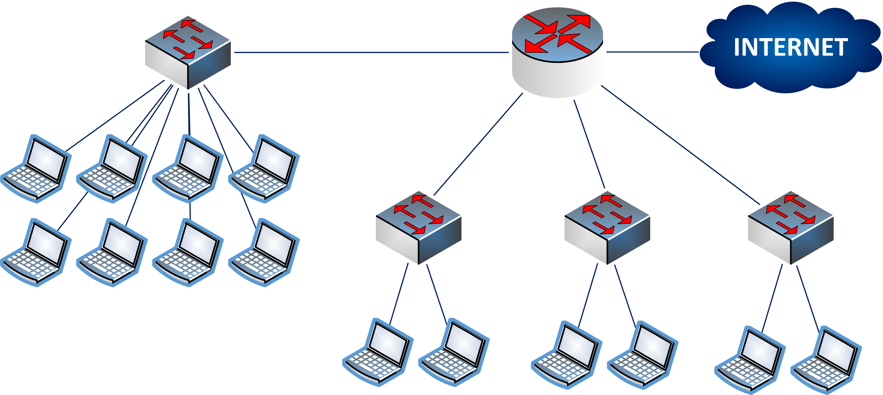
A Simple Example
192.168.1.0

Slide 5

A Simple Example
192.168.1.0

Slide 6
A Simple Example
Request: create 4 subnets, where 3 subnets should have 5 IP addresses each, and 1 subnet needs 11 addresses.

Slide 7
A Simple Example
Request: create 4 subnets, where 3 subnets should have 5 IP addresses each, and 1 subnet needs 11 addresses.
The FLSM Solution:
Subnet | Number of hosts | Mask | Network ID | Range of ‘useful’ addresses
#1 | 11 | /28 | 192.168.1.0 | 192.168.1.1 – 192.168.1.14
#2 | 5 | /28 | 192.168.1.16 | 192.168.1.17 – 192.168.1.30
#3 | 5 | /28 | 192.168.1.32 | 192.168.1.33 – 192.168.1.46
#4 | 5 | /28 | 192.168.1.48 | 192.168.1.49 – 192.168.1.62

Slide 8
A Simple Example
Request: create 4 subnets, where 3 subnets should have 5 IP addresses each, and 1 subnet needs 11 addresses.
The VLSM Solution:
Subnet | Number of hosts | Mask | Network ID | Range of ‘useful’ addresses
#1 | 11 | /28
#2 | 5
#3 | 5
#4 | 5

Slide 9
A Simple Example
Request: create 4 subnets, where 3 subnets should have 5 IP addresses each, and 1 subnet needs 11 addresses.
The VLSM Solution:
Subnet | Number of hosts | Mask | Network ID | Range of ‘useful’ addresses
#1 | 11 | /28 | 192.168.1.0
#2 | 5
#3 | 5
#4 | 5

Slide 10
A Simple Example
Request: create 4 subnets, where 3 subnets should have 5 IP addresses each, and 1 subnet needs 11 addresses.
The VLSM Solution:
Subnet | Number of hosts | Mask | Network ID | Range of ‘useful’ addresses
#1 | 11 | /28 | 192.168.1.0 | 192.168.1.1 – 192.168.1.14
#2 | 5
#3 | 5
#4 | 5

Slide 11
A Simple Example
Request: create 4 subnets, where 3 subnets should have 5 IP addresses each, and 1 subnet needs 11 addresses.
The VLSM Solution:
Subnet | Number of hosts | Mask | Network ID | Range of ‘useful’ addresses
#1 | 11 | /28 | 192.168.1.0 | 192.168.1.1 – 192.168.1.14
#2 | 5 | /29
#3 | 5
#4 | 5

Slide 12
A Simple Example
Request: create 4 subnets, where 3 subnets should have 5 IP addresses each, and 1 subnet needs 11 addresses.
The VLSM Solution:
Subnet | Number of hosts | Mask | Network ID | Range of ‘useful’ addresses
#1 | 11 | /28 | 192.168.1.0 | 192.168.1.1 – 192.168.1.14
#2 | 5 | /29 | 192.168.1.16
#3 | 5
#4 | 5

Slide 13
A Simple Example
Request: create 4 subnets, where 3 subnets should have 5 IP addresses each, and 1 subnet needs 11 addresses.
The VLSM Solution:
Subnet | Number of hosts | Mask | Network ID | Range of ‘useful’ addresses
#1 | 11 | /28 | 192.168.1.0 | 192.168.1.1 – 192.168.1.14
#2 | 5 | /29 | 192.168.1.16 | 192.168.1.17 – 192.168.1.22
#3 | 5
#4 | 5

Slide 14
A Simple Example
Request: create 4 subnets, where 3 subnets should have 5 IP addresses each, and 1 subnet needs 11 addresses.
The VLSM Solution:
Subnet | Number of hosts | Mask | Network ID | Range of ‘useful’ addresses
#1 | 11 | /28 | 192.168.1.0 | 192.168.1.1 – 192.168.1.14
#2 | 5 | /29 | 192.168.1.16 | 192.168.1.17 – 192.168.1.22
#3 | 5 | /29
#4 | 5

Slide 15
A Simple Example
Request: create 4 subnets, where 3 subnets should have 5 IP addresses each, and 1 subnet needs 11 addresses.
The VLSM Solution:
Subnet | Number of hosts | Mask | Network ID | Range of ‘useful’ addresses
#1 | 11 | /28 | 192.168.1.0 | 192.168.1.1 – 192.168.1.14
#2 | 5 | /29 | 192.168.1.16 | 192.168.1.17 – 192.168.1.22
#3 | 5 | /29 | 192.168.1.24
#4 | 5

Slide 16
A Simple Example
Request: create 4 subnets, where 3 subnets should have 5 IP addresses each, and 1 subnet needs 11 addresses.
The VLSM Solution:
Subnet | Number of hosts | Mask | Network ID | Range of ‘useful’ addresses
#1 | 11 | /28 | 192.168.1.0 | 192.168.1.1 – 192.168.1.14
#2 | 5 | /29 | 192.168.1.16 | 192.168.1.17 – 192.168.1.22
#3 | 5 | /29 | 192.168.1.24 | 192.168.1.25 – 192.168.1.30
#4 | 5

Slide 17
A Simple Example
Request: create 4 subnets, where 3 subnets should have 5 IP addresses each, and 1 subnet needs 11 addresses.
The VLSM Solution:
Subnet | Number of hosts | Mask | Network ID | Range of ‘useful’ addresses
#1 | 11 | /28 | 192.168.1.0 | 192.168.1.1 – 192.168.1.14
#2 | 5 | /29 | 192.168.1.16 | 192.168.1.17 – 192.168.1.22
#3 | 5 | /29 | 192.168.1.24 | 192.168.1.25 – 192.168.1.30
#4 | 5 | /29

Slide 18
A Simple Example
Request: create 4 subnets, where 3 subnets should have 5 IP addresses each, and 1 subnet needs 11 addresses.
The VLSM Solution:
Subnet | Number of hosts | Mask | Network ID | Range of ‘useful’ addresses
#1 | 11 | /28 | 192.168.1.0 | 192.168.1.1 – 192.168.1.14
#2 | 5 | /29 | 192.168.1.16 | 192.168.1.17 – 192.168.1.22
#3 | 5 | /29 | 192.168.1.24 | 192.168.1.25 – 192.168.1.30
#4 | 5 | /29 | 192.168.1.32

Slide 19
A Simple Example
Request: create 4 subnets, where 3 subnets should have 5 IP addresses each, and 1 subnet needs 11 addresses.
The VLSM Solution:
Subnet | Number of hosts | Mask | Network ID | Range of ‘useful’ addresses
#1 | 11 | /28 | 192.168.1.0 | 192.168.1.1 – 192.168.1.14
#2 | 5 | /29 | 192.168.1.16 | 192.168.1.17 – 192.168.1.22
#3 | 5 | /29 | 192.168.1.24 | 192.168.1.25 – 192.168.1.30
#4 | 5 | /29 | 192.168.1.32 | 192.168.1.33 – 192.168.1.38

Slide 20
A Simple Example
Subnet | Number of hosts | Mask | Network ID | Range of ‘useful’ addresses
#1 | 11 | /28 | 192.168.1.0 | 192.168.1.1 – 192.168.1.14
#2 | 5 | /28 | 192.168.1.16 | 192.168.1.17 – 192.168.1.30
#3 | 5 | /28 | 192.168.1.32 | 192.168.1.33 – 192.168.1.46
#4 | 5 | /28 | 192.168.1.48 | 192.168.1.49 – 192.168.1.62
Request: create 4 subnets, where 3 subnets should have 5 IP addresses each, and 1 subnet needs 11 addresses.
The VLSM Solution:
Subnet | Number of hosts | Mask | Network ID | Range of ‘useful’ addresses
#1 | 11 | /28 | 192.168.1.0 | 192.168.1.1 – 192.168.1.14
#2 | 5 | /29 | 192.168.1.16 | 192.168.1.17 – 192.168.1.22
#3 | 5 | /29 | 192.168.1.24 | 192.168.1.25 – 192.168.1.30
#4 | 5 | /29 | 192.168.1.32 | 192.168.1.33 – 192.168.1.38

Slide 21
A Simple Example
FLSM
Subnet | Number of hosts | Mask | Network ID | Range of ‘useful’ addresses
#1 | 11 | /28 | 192.168.1.0 | 192.168.1.1 – 192.168.1.14
#2 | 5 | /28 | 192.168.1.16 | 192.168.1.17 – 192.168.1.30
#3 | 5 | /28 | 192.168.1.32 | 192.168.1.33 – 192.168.1.46
#4 | 5 | /28 | 192.168.1.48 | 192.168.1.49 – 192.168.1.62
Request: create 4 subnets, where 3 subnets should have 5 IP addresses each, and 1 subnet needs 11 addresses.
The VLSM Solution:
Subnet | Number of hosts | Mask | Network ID | Range of ‘useful’ addresses
#1 | 11 | /28 | 192.168.1.0 | 192.168.1.1 – 192.168.1.14
#2 | 5 | /29 | 192.168.1.16 | 192.168.1.17 – 192.168.1.22
#3 | 5 | /29 | 192.168.1.24 | 192.168.1.25 – 192.168.1.30
#4 | 5 | /29 | 192.168.1.32 | 192.168.1.33 – 192.168.1.38

Slide 22
A Simple Example
FLSM
Subnet | Number of hosts | Mask | Network ID | Range of ‘useful’ addresses
#1 | 11 | /28 | 192.168.1.0 | 192.168.1.1 – 192.168.1.14
#2 | 5 | /28 | 192.168.1.16 | 192.168.1.17 – 192.168.1.30
#3 | 5 | /28 | 192.168.1.32 | 192.168.1.33 – 192.168.1.46
#4 | 5 | /28 | 192.168.1.48 | 192.168.1.49 – 192.168.1.62
Request: create 4 subnets, where 3 subnets should have 5 IP addresses each, and 1 subnet needs 11 addresses.
The VLSM Solution:
VLSM
Subnet | Number of hosts | Mask | Network ID | Range of ‘useful’ addresses
#1 | 11 | /28 | 192.168.1.0 | 192.168.1.1 – 192.168.1.14
#2 | 5 | /29 | 192.168.1.16 | 192.168.1.17 – 192.168.1.22
#3 | 5 | /29 | 192.168.1.24 | 192.168.1.25 – 192.168.1.30
#4 | 5 | /29 | 192.168.1.32 | 192.168.1.33 – 192.168.1.38

Slide 23
IP Subnetting – Zero to Hero Variable-Length Subnet Mask (VLSM)
CyberQuince

